Slide 1
ECE 228 IPU Matrix Multiplier
Kyle Goodman
Samantha Lewandoski
Nathan Randall

Slide 2
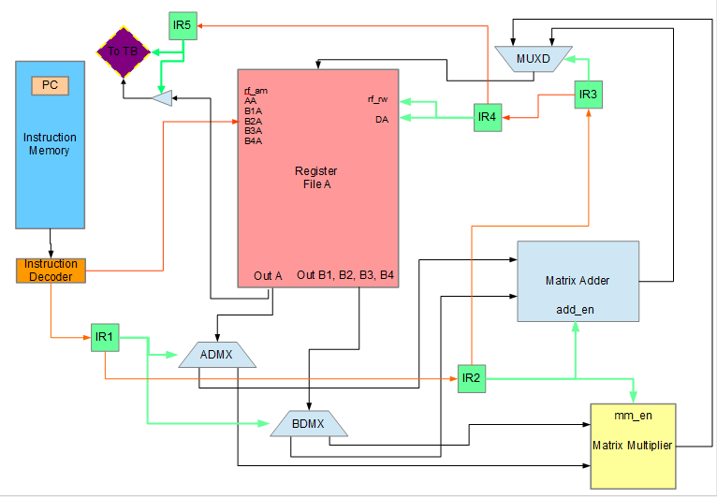
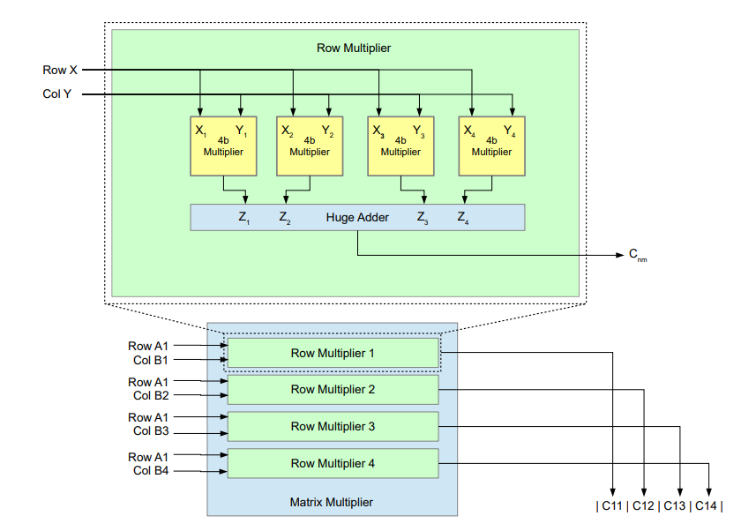
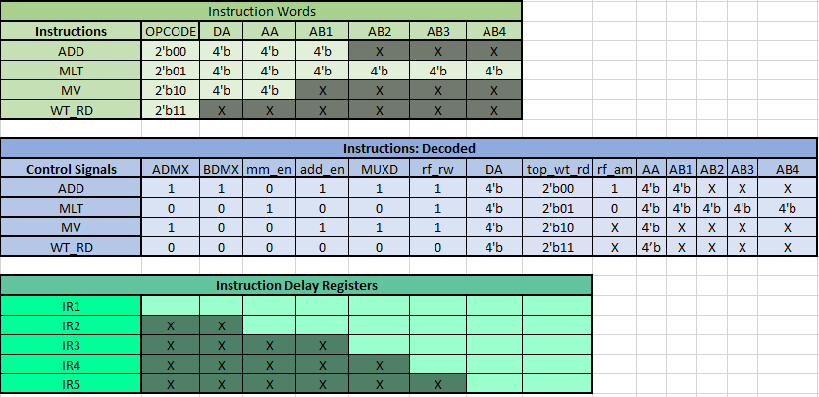
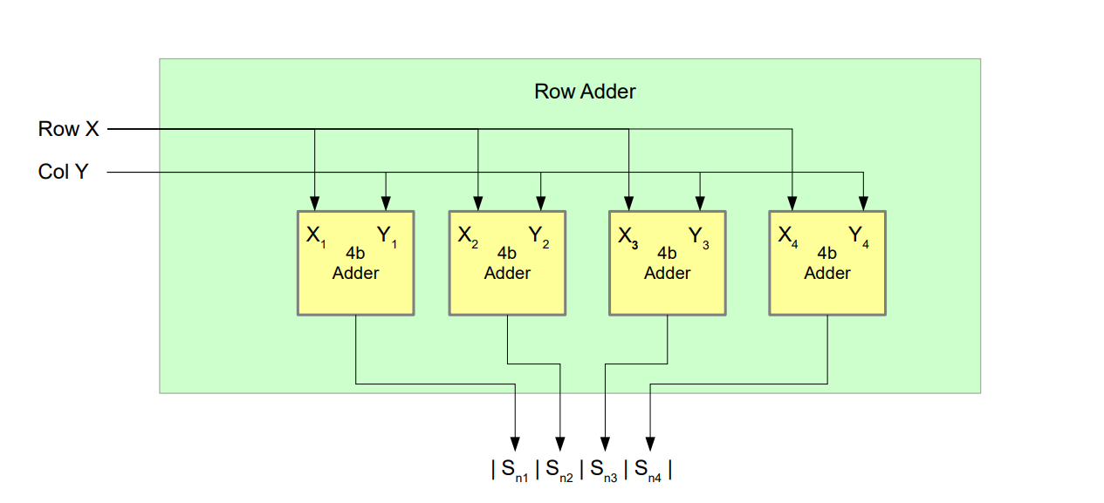
Block Design Overview
Block Design Matrix Multiplier
Instruction Design
Block Design Matrix Adder

Slide 3
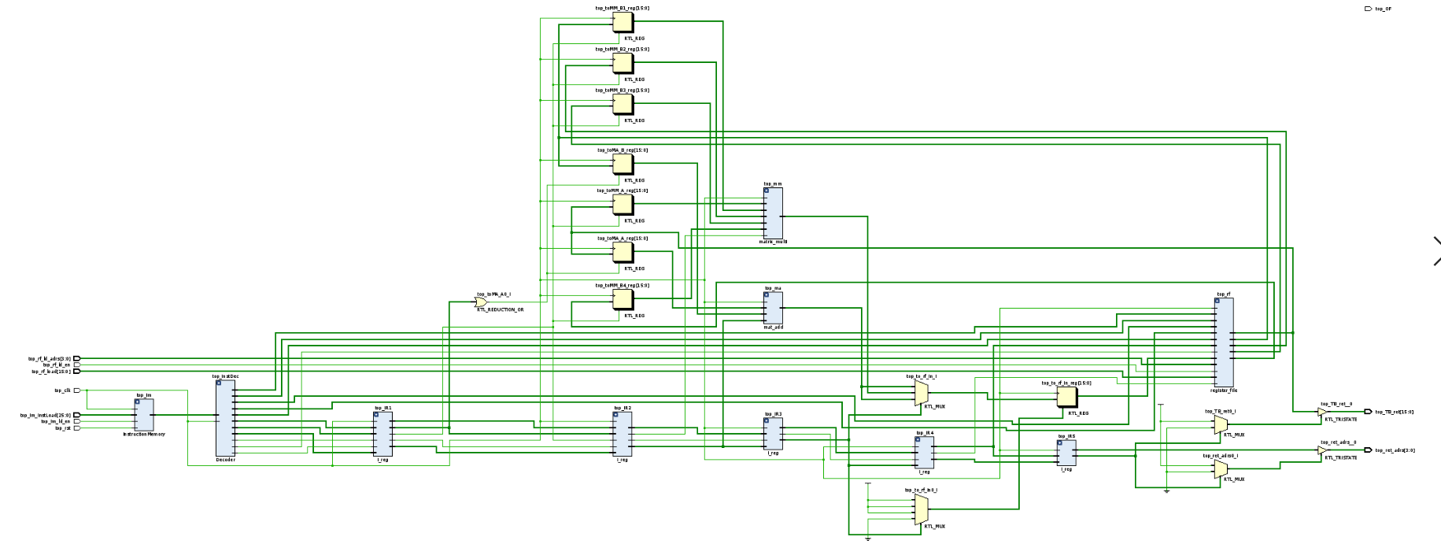
IPU Schematic

Slide 4
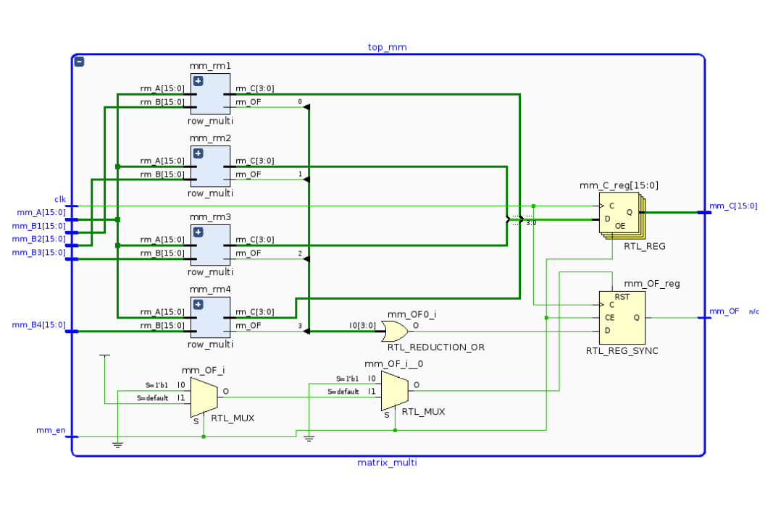

Matrix Multiplier Schematic
Row Multiplier

Slide 5
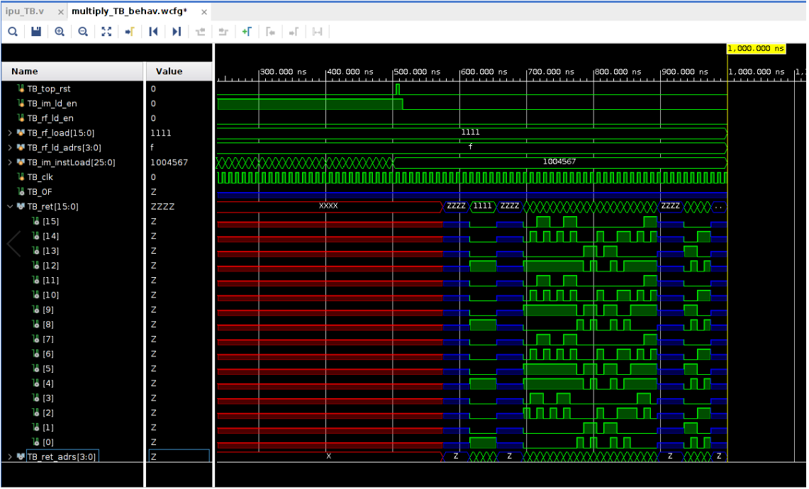
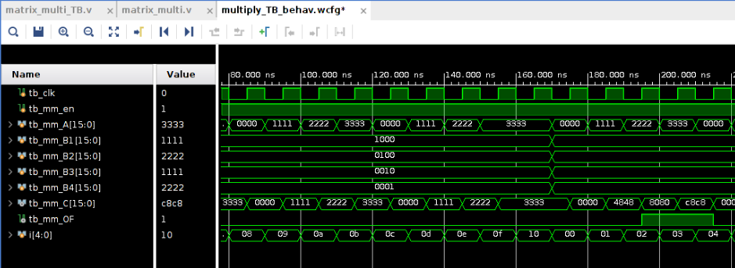
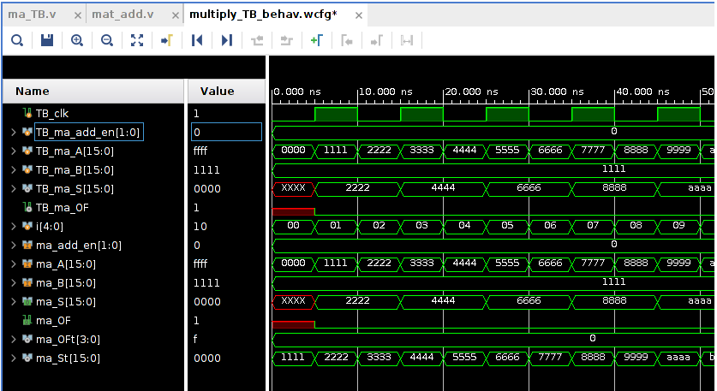
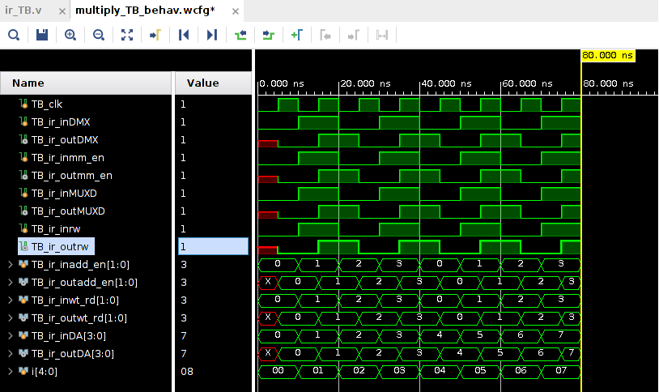
Instruction Register
IPU Top
Matrix Multiplier
Matrix Adder

Slide 6
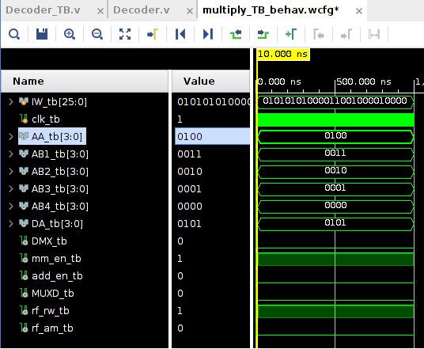
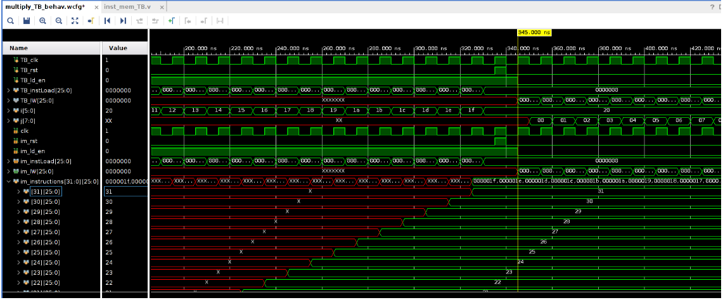
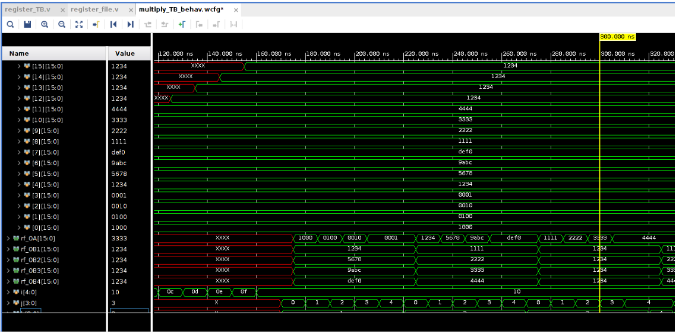
Instruction Decoder
Instruction Memory
Resister File

